Slide 1
ENGG1003
Introduction to procedural programming

Slide 2
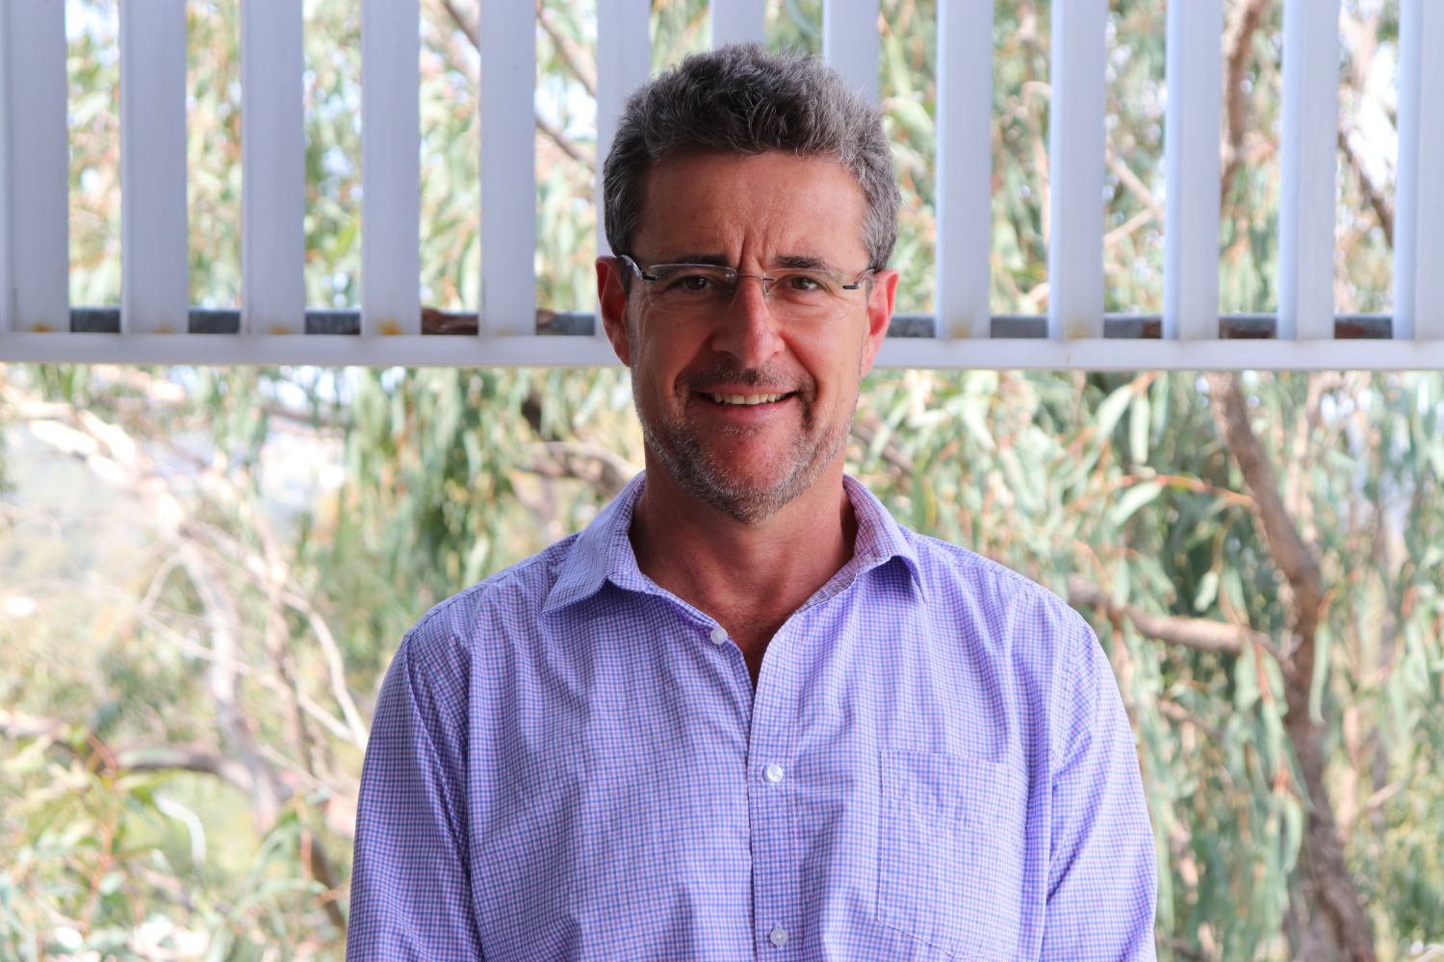
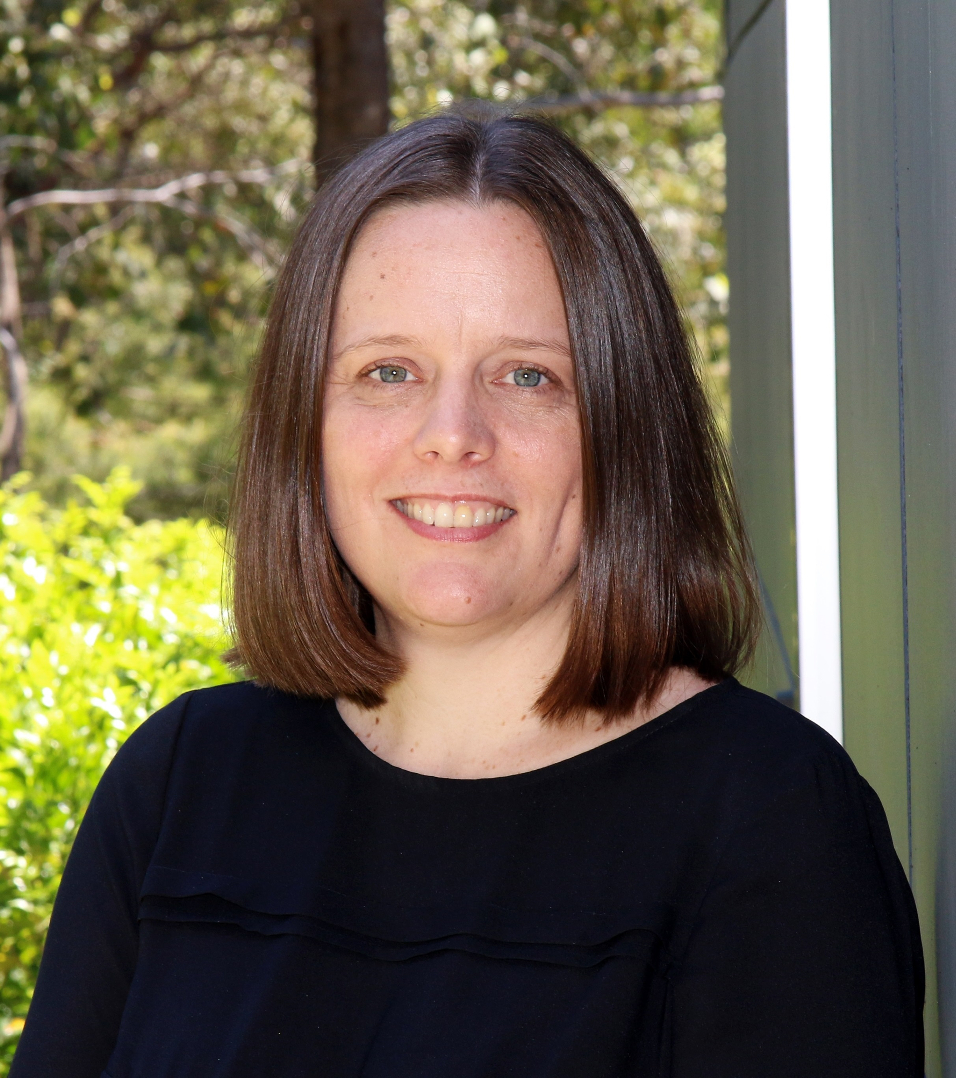
Staff
Course Coordinator: Prof. Steven Weller
Steven.Weller@newcastle.edu.au
Prof. Sarah Johnson
Sarah.Johnson@newcastle.edu.au
Mr. Brenton Schulz
Brenton.Schulz@newcastle.edu.au
See course outline for consultation hours
Lab demonstrators
Too many to mention, you'll meet them in labs
Mix of postgrad and undergrad students
Ask them about their work, future studies, etc!
Steve
Sarah

Slide 3
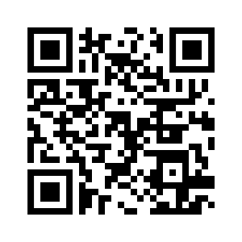
Blackboard
Accessed via: http://uonline.newcastle.edu.au
Does anyone use QR codes? Didn't think so, have one anyway.
All courses upload notes, lecture recordings, announcements, grades, etc. to Blackboard
Your responsibility to check regularly, typically daily.

Slide 4

Discord
We will be utilizing Discord
Invite link: https://discord.gg/sfgpR4kMbN
Great for:
Quick questions
Much faster than email!
Connecting with peers
Can be used as online consultation if Zoom doesn’t work
Staff will participate

Slide 5
Course Classes
Two lectures per week – both via Zoom
This one (Mon 9-11am for those watching the recording)
Thursday 4-5pm
Two computer labs - Start this week!
One on campus
You sit at a PC among 20-40 other students and get given tasks to do
Tasks distributed on Blackboard, typically a PDF, maybe template code
One or two demonstrators are paid to be there and answer your questions
One via Zoom – links will be on Blackboard

Slide 6
Textbooks
S. Linge & H.P. Langtangen, Programming for Computations – Python (2nd edition), Springer Open, 2020. ISBN 978-3-030-16876-6 ISBN 978-3-030-16877-3 (eBook)
This textbook is an open access publication, available for free as an eBook via the University of Newcastle library.
Direct link: https://link.springer.com/book/10.1007%2F978-3-030-16877-3

Slide 7
Thinking of dropping Out?
Come talk to us! What can be done to help?
HECS Census: 19 March
Last day to withdraw without financial or academic penalty
Withdrawing between 20 March and 4 June does not incur academic penalty
You still pay for the course
Withdrawing 12:00:01am on 5 June or after results in a fail

Slide 8
Where to find help
Google
Copy/paste error messages
Search for Python tutorials (there are lots)
Discord
A peer or staff member might be around to help you
Your lab demonstrator
Only during enrolled lab times
They will help you do simple debugging, search for solutions, read documentation, etc
The textbook

Slide 9
Assessments
Passing grade is 50%
Must also score 40% or higher in the final exam
Assessed Laboratory 1 Week 4, 5%
Mid-semester quiz Week 6, 15%
Programming assignment 1 Week 7, 20%
Assessed Laboratory 2 Week 9, 5%
Assessed Laboratory 3 Week 11, 5%
Programming assignment 2 Week 13, 15%
Final Exam Final exam period, 35%

Slide 10
Attendance
An overall attendance of at least 80% is required for on-campus labs
ie: mandatory attendance applies to weekly 2-hour computer lab in ENGG1003
Uni-wide policy applies to all students in 1000-level courses e.g. ENGG1003
Mandatory attendance does NOT apply to the weekly 1-hour Zoom lab
Do NOT attend a lab if you are unwell!
Attending a later lab session does not require a medical certificate
If attending a later lab session, advise the demonstrator in that session

Slide 11
Assessments
Programming is quite unforgiving
If you develop code on a private machine it may not work on the university computers
Assessment demonstration on privately owned laptops is totally fine, if not preferred
All assessments (except the final exam) are graded during your lab session
Assessment in a different lab session requires approval

Slide 12
What is "Procedural Programming"?
Telling a computer what to do via a list of steps
Written in a language the computer can understand
Ideally, the human writing understands it too
This course uses the language “Python”
Top language in IEEE survey multiple years running
Incredibly useful in isolation; fantastic platform to learn basics before learning other languages

Slide 13
Why do I need programming?
ELEC/MECHA/Computer systems engineering
Embedded systems, programming small computers in home appliances, UAVs, wireless sensors, internet of things (IoT) devices, etc
You will all do this in ENGG1500 on the “STM32" microcontroller platform using microPython
Control systems – MATLAB (possibly also Python)
Designing mathematical models which make a thing do a thing
Eg: Car cruise control, temperature control, controlling robot arms, etc
Numerical methods
Catch-all term for any kind of heavy lifting arithmetic done on a PC or supercomputer
Applications typically quite specific

Slide 14
Why do I need programming?
MECH/CHEM/Medical/Aerospace
Many of you will program embedded systems in C later on
Eg: MECH students use Arduinos in 2nd year
Almost all medical equipment is an "embedded" system
MATLAB is used extensively for various applications, Python slowly taking over
Ask your demonstrators in other courses?

Slide 15
What Is A Computer?
How is this relevant to this course?
In order to write instructions (programming), you must have a relevant understanding of how computers work
A computer is an electronic device designed to perform calculations very quickly
This seems rather restrictive, just performing mathematics
But when you consider its other capabilities
Speed
Communication with other electronic devices (peripherals)
Then mathematics gives you
A word processor, sinus rhythms of a person's heart, how the ailerons should move to bank a plane, how a robot should weld a car body, how much heat is needed to maintain a chemical reaction, weather predictions, etc.
Notes:
Rather restrictive, after all what possible use is a machine that can only do mathematics?

Slide 16
Fundamental Components
Fundamental components of every computer
INPUT
PROCESSING
OUTPUT

Slide 17
Input
Computers only understand electrical signals
More specifically those signals represent two states ON or OFF (binary 0 or 1)
What about a keyboard?
It is a device which converts each keystroke into a series of ON/OFF voltages
What about a mouse?
It is a device which converts movements into a series of ON/OFF voltages
For our model we consider input to be
Any series of ON/OFF voltages which the computer needs to perform its calculations
A device that generates input we will call an input device
Notes:
You might argue that we type on a keyboard which consists of 26 letters, 10 numbers and various other function buttons

Slide 18
PROCESSING
Processing is the main function of a computer
Once the input for a calculation is available, the computer will perform some processing
Processing is a series of manipulations performed on the input
This involves following a very specific set of instructions
Instructions can be ADD, SUB, MUL, DIV, MOV, SQRT, etc...
The writing of those instructions is called programming

Slide 19
OUTPUT
Once the processing is complete
The computer must have a way of presenting the results
This is the output
Output is any series of ON/OFF voltages that represents the results of processing
To make the output more useful we need an output device

Slide 20
Output
An output device is any peripheral that takes a series of ON/OFF voltages and manipulates them into something useful or human readable
Examples:
Printer
Monitor
Automotive cruise control throttle actuators
LCD showing the oxygenation level of a patient’s blood
Rudder adjustment in a fly-by-wire system

Slide 21
EXAMPLE Fundamental Components
Fundamental components of every computer
INPUT
PROCESSING
OUTPUT
ON
and
Add the two inputs
ON
OFF
OFF
00010101
and
10011001
10101110
21
and
153
174

Slide 22
PROCESSING In Detail
Processing is complex
Requires multiple key sub-components to help
For our purposes we define
PROCESSOR
MEMORY
SOFTWARE
INPUT
PROCESSING
OUTPUT
PROCESSOR
MEMORY
SOFTWARE (INSTRUCTIONS)
DATA (SCRATCHPAD)

Slide 23
Processing in Detail - PROCESSOR
Processor
Performs mathematical and data manipulation tasks
Has sub-components, but they are not relevant for this course
More detail in ELEC1710

Slide 24
Processing in detail - Everything is a number
Computers can only process numbers
Things that aren’t numbers need numerical "codes"
Text: ASCII and Unicode
Pictures: most commonly, each pixel is allocated a red-green-blue intensity value
Sound: the “waveform” is sampled at regular intervals and stored as a series of numbers
(NB: multiple standards exist for all the above)

Slide 25
Processing in Detail - MEMORY
Memory
Like humans, computers need to store intermediate results
Memory acts like a set of written notes for the computer
Further relevant subdivision
Software – Instructions for the calculation
Data – The information required for the calculation

Slide 26
Processing in Detail - Software
Software
This is the main event for this course (the Python interpreter)
These are the detailed instructions that the processor will follow to perform the desired calculations
Instructions directly understood by the processor are
Very specific to each processor (known as the instruction set)
Limited in number
Simple, eg: add number in memory location 1 to the number in memory location 2 and put the result in memory location 3
Again each instruction is encoded as a series of ON/OFF voltages

Slide 27
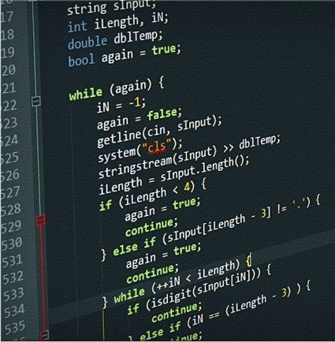
SOFTWARE
Software for our purpose will be divided into three groups
Machine code
Assembly language
“High level” languages

Slide 28
SOFTWARE – MACHINE Code
The processor can only understand machine code
Example, one instruction for an x86-based CPU
0110 0110 1000 0011 1100 0000 0000 1010
Difficult for humans to understand
Very processor-specific
Will not be understood by another processor

Slide 29
SOFTWARE – ASSEMBLY LANGUAGE
Assembly Language
Uses simple mnemonics to describe the purpose of the instruction
Example, one instruction for a x86 based CPU
Machine code: 0110 0110 1000 0011 1100 0000 0000 1010
Assembly language: ADD AX, 10
A bit easier for humans to understand
Still processor-specific

Slide 30
SOFTWARE – Higher-Level LANGUAGEs
High level Languages (C, MATLAB, Java, Python, C++, FORTRAN,…)
Uses more human readable text-based code
Increases the complexity of each line of code so that common calculations can be done with fewer lines
Example, one instruction for a x86-based CPU
Machine code: 0110 0110 1000 0011 1100 0000 0000 1010
Assembly language: ADD AX, 10
In Python: x = x + 10
Much easier for humans to understand
Not processor specific
Allows writing of much more complicated instructions

Slide 31
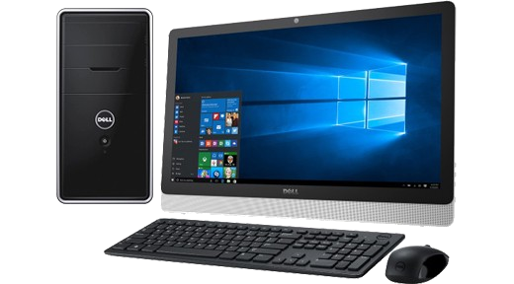
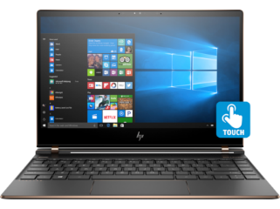
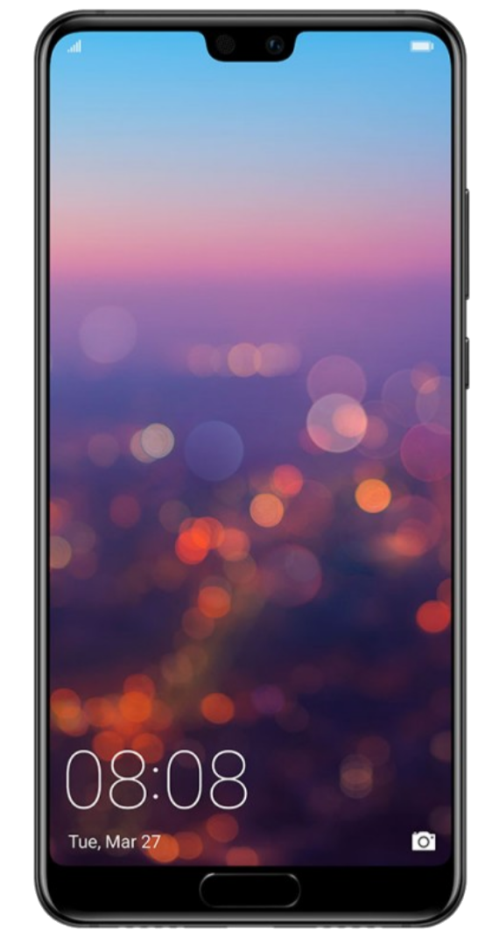
Recognising Computers
Device | Specification
Desktop PC | INPUT DEVICE: Keyboard and Mouse OUTPUT DEVICE: Monitor, Speakers PROCESSING: PROCESSOR: Intel i7 64-bit CPU MEMORY: 8GB RAM
Laptop | INPUT DEVICE: Keyboard and Touch Display OUTPUT DEVICE: Monitor, Speakers PROCESSING: PROCESSOR: Intel i7 64-bit CPU MEMORY: 8GB RAM
Smart Phone | INPUT DEVICE: Touch Sensor, Microphone, Accelerometers, GPS receiver, 4G Receiver OUTPUT DEVICE: Display, Speaker PROCESSING: PROCESSOR: Qualcomm Snapdragon 808 ARMv8-A 64-bit CPU MEMORY: 8GB RAM

Slide 32
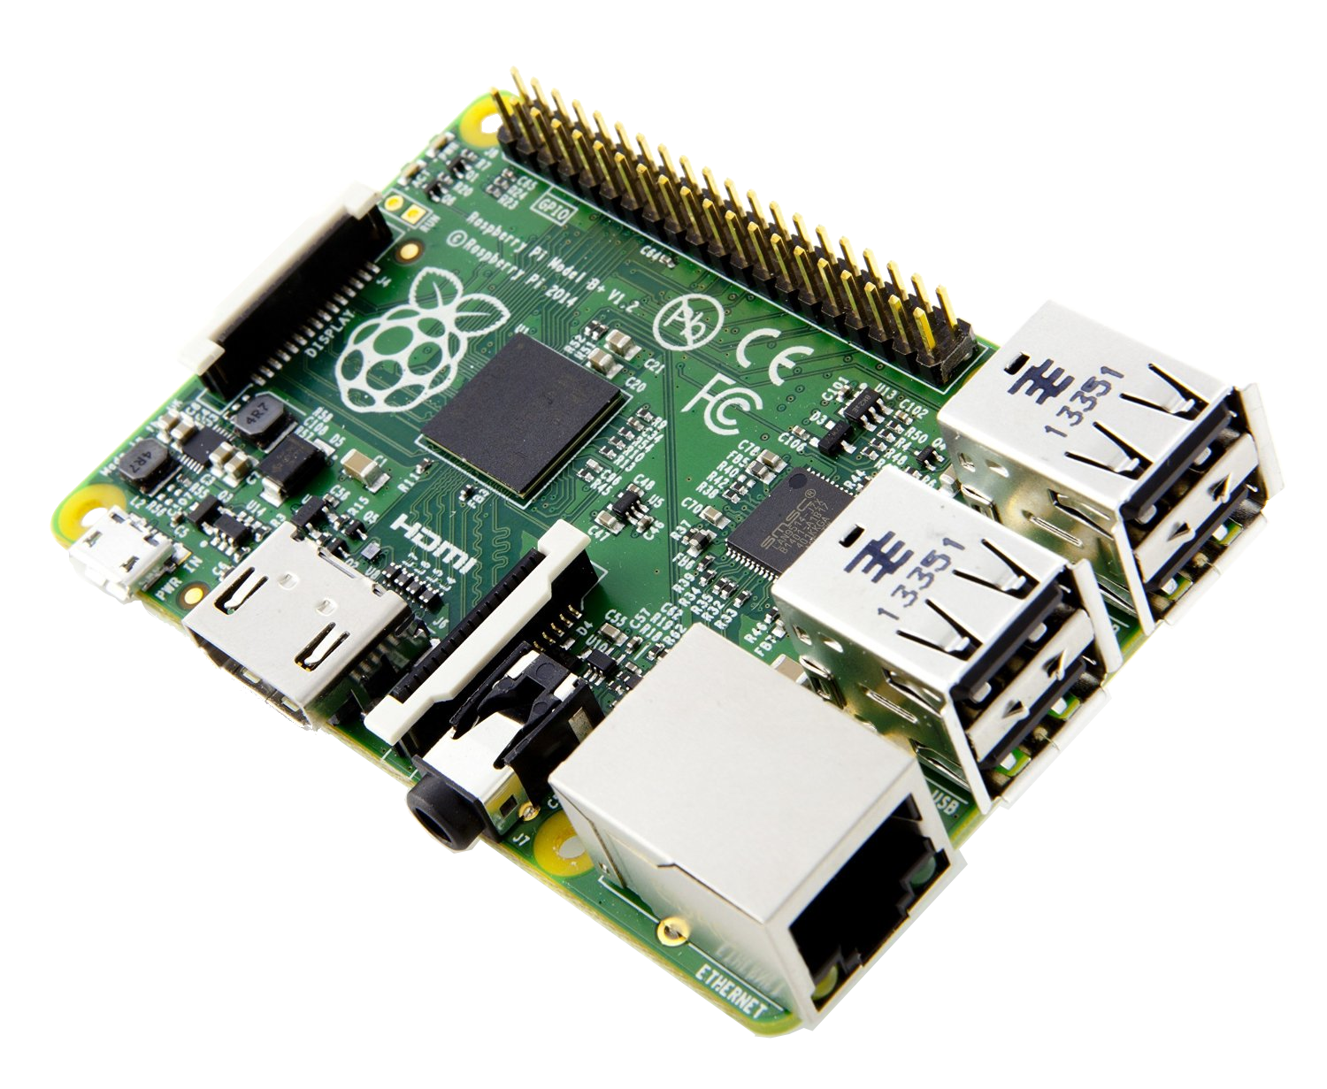
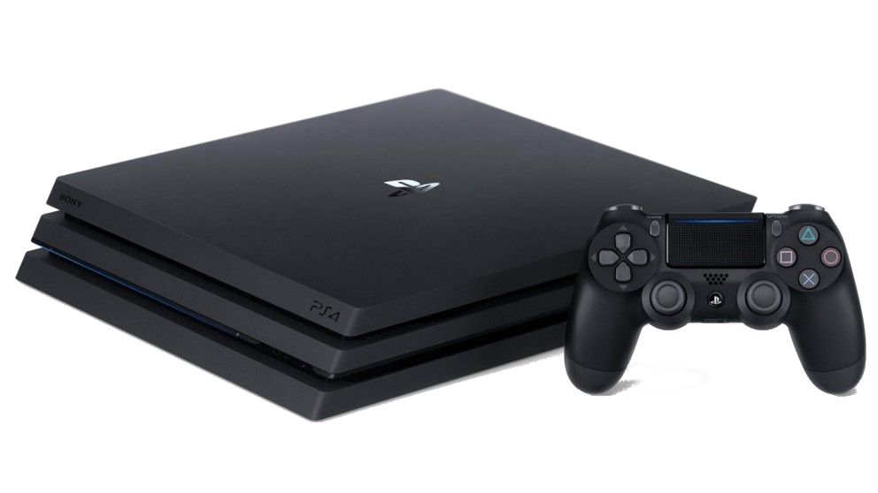
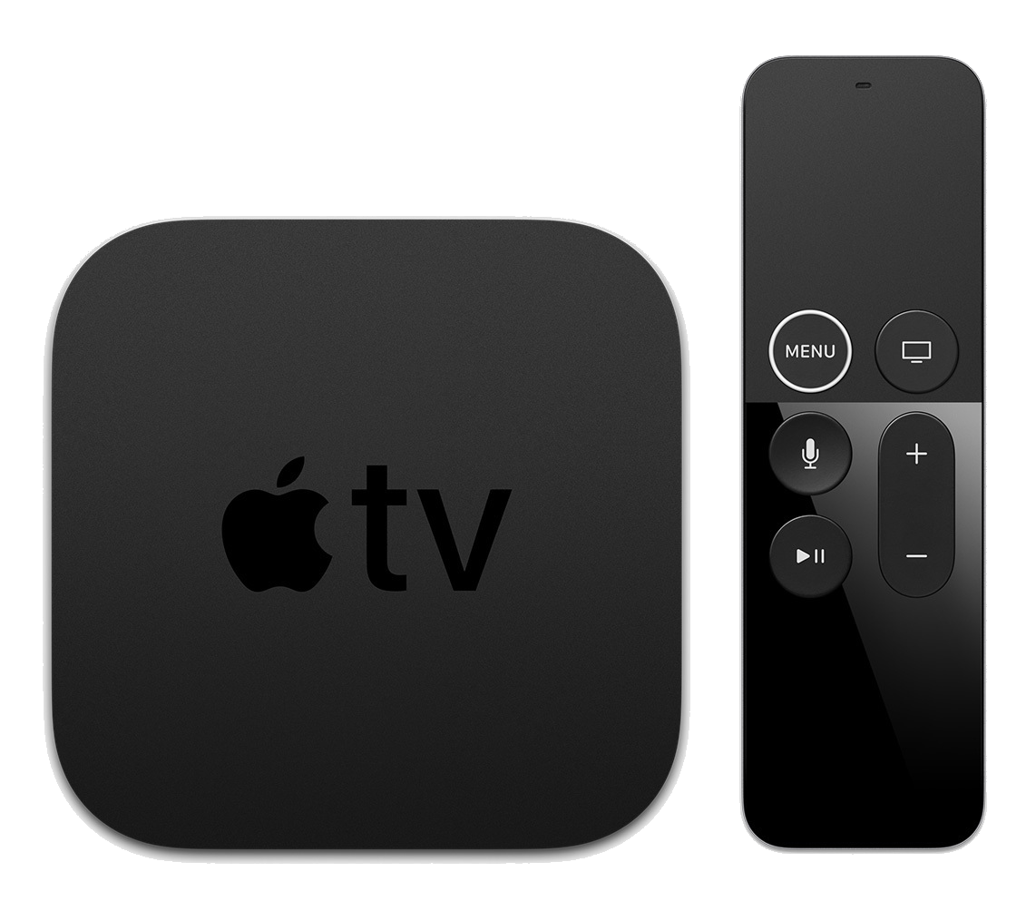
Recognising Computers
Device | Specification
Raspberry Pi 3+ | INPUT DEVICE: Keyboard, Electrical signals (I/O) OUTPUT DEVICE: HDMI Port to Display, USB, Audio PROCESSING: PROCESSOR: Broadcom BCM2837B0 64-bit quad-core ARM Cortex-A53 CPU MEMORY: 1GB RAM
Sony PlayStation 4 | INPUT DEVICE: Gaming Controller OUTPUT DEVICE: HDMI Port to Display PROCESSING: PROCESSOR: AMD x86-64 “Jaguar” CPU MEMORY: 8GB RAM
Apple TV | INPUT DEVICE: Remote control OUTPUT DEVICE: HDMI Port to Display PROCESSING: PROCESSOR: Apple A10X Fusion ARM 64-bit CPU MEMORY: 2GB RAM

Slide 33
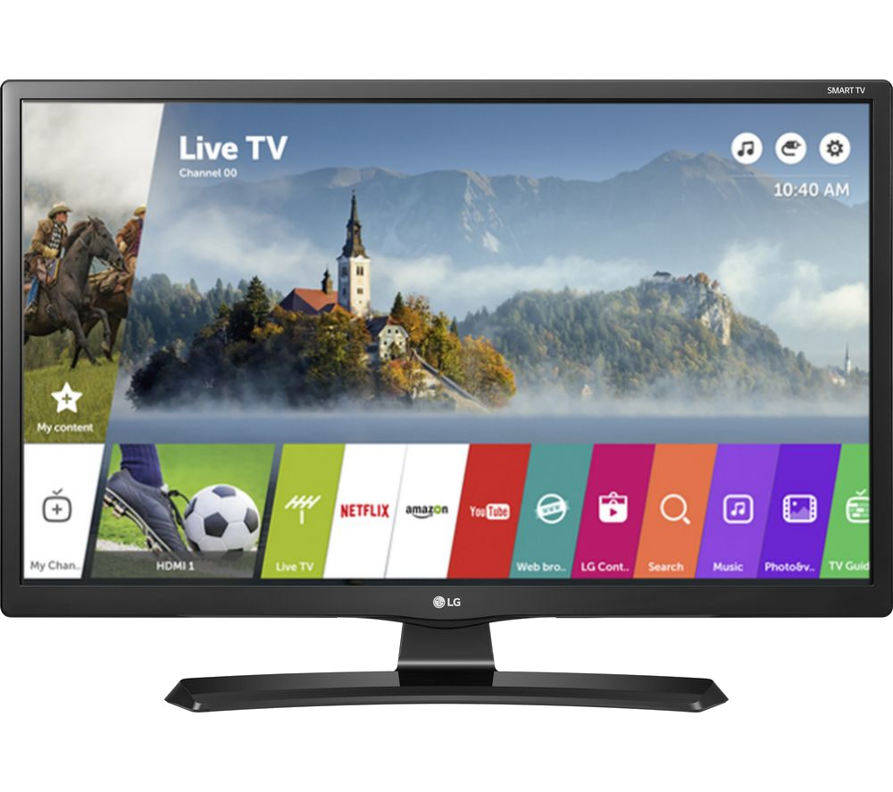
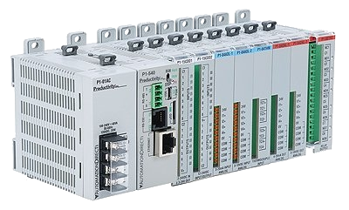
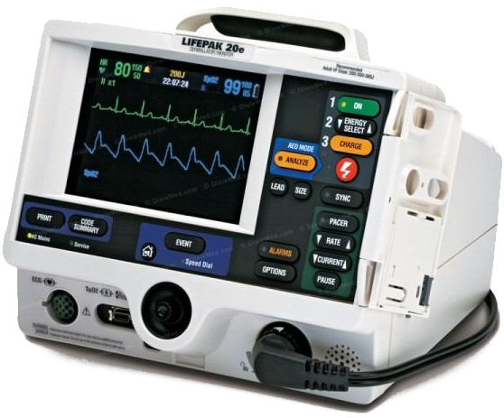
Recognising Computers
Device | Specification
Smart TV | INPUT DEVICE: Remote OUTPUT DEVICE: Display PROCESSING: PROESSOR: Dual-core ARM Cortex-A9 1Ghz MEMORY: 1GB RAM
PLC (Programmable Logic Controller) | INPUT DEVICE: Electrical signals OUTPUT: Electrical signals PROCESSING: PROCESSOR: Intel 8051 CPU MEMORY: SOFTWARE: 2KB RAM DATA: 128B RAM
Defibrillator | INPUT DEVICE: Electrical signals from electrodes OUTPUT: Defibrillation current PROCESSING: PROCESSOR: STM32 STM32F429 ARM-Cortex M4 32-bit CPU MEMORY: 256KB RAM

Slide 34
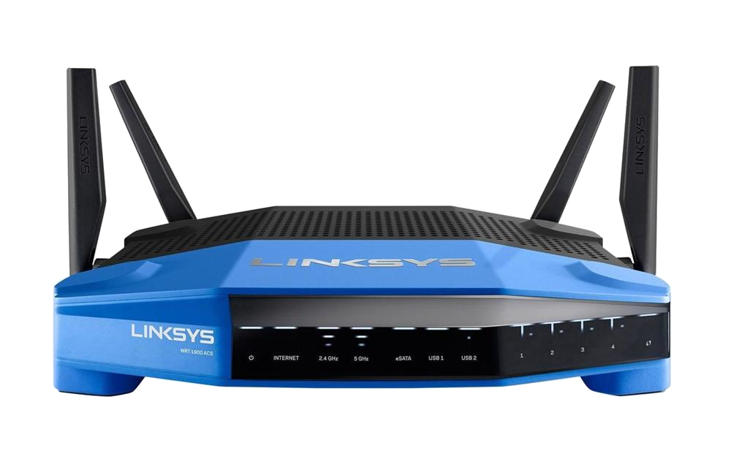
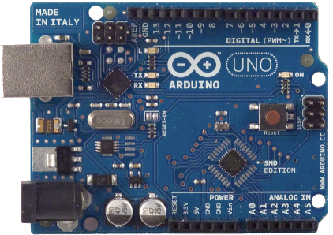
Recognising Computers
Device | Specification
Network Router | INPUT DEVICE: Ethernet, Radio Signals OUTPUT DEVICE: Ethernet, Antennae PROCESSING: PROCESSOR: Broadcom BCM21664T Dual-core ARM Cortex-A9 32-bit CPU MEMORY: 1GB RAM
Arduino UNO | INPUT DEVICE: Electrical signals OUTPUT: Electrical signals PROCESSING PROCESSOR: Microchip ATmega328 8-bit Microcontroller (CPU) MEMORY: SOFTWARE: 32KB RAM DATA: 2KB RAM

Slide 35
RECOGNISING Computers
All these devices are
Computers
Have the fundamental elements input, processing, and output
What does this mean for you as a programmer?
Be aware that your target computer may have limitations
Different computers have different programming requirements

Slide 36
INTRODUCTION TO PYTHON – FUNDAMENTAL CONCEPTS
Python is an interpreted language
This means an interpreter takes code from a text file or command prompt and converts it into machine instructions “on the fly”
Machine instructions are then executed by a computer
In this course "computer" will be a PC or laptop
Could be a microcontroller, mobile phone, supercomputer cluster, etc
We will use the PyCharm integrated development environment (IDE)
Download “community edition” from: https://www.jetbrains.com/pycharm/download/#section=windows

Slide 37
Introduction to Python – Fundamental Concepts
Moving data into and out of a Python program
Standard input: text characters read from a keyboard
Standard output: text characters sent to the screen
Typically printed to a console
File I/O: from or to files stored on a hard disk / USB flash drive / etc
Covered in later weeks

Slide 38
Introduction to Python –Fundamental Concepts
Other input/output methods beyond this course:
Microcontroller pins (GPIO – in ENGG1500 and ELEC1710)
Embedded systems communication standards, covered in ELEC2720, ELEC3730, MCHA-something
I2C
SPI
UART
TCP/IP networking
USB devices
Loads of others

Slide 39
Some basic Python programs
Being an interpreted language Python programs can be just one line:
Examples (introduce PyCharm, run live!)
print(“hello”)
1+1
print(1+1)

Slide 40
Syntax
What on Earth is syntax?
In human languages: the order of words in a sentence
Are you going to the movies on Tuesday?
Are you on Tuesday to the movies going?
In computer languages: the structure of the text given to the compiler
For example, print(“hello”) is different from print(hello) or print hello

Slide 41
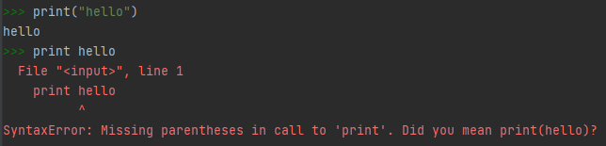
Syntax
The syntax rules in programming are typically very strict
Incorrect syntax can result in Python generating syntax errors
Eg:

Slide 42
Case Sensitivity
Most programming languages are case sensitive
This means that print()is totally different to Print()or PRINT()
Fundamental reason: p and P are different ASCII characters
ASCII maps letters to numbers because computers only work with numbers

Slide 43
Fundamental Concepts – Input
We saw print() for text output
One function which reads standard input is input()
It reads input text and converts it into other datatypes
Eg: converts the text “13” to the number 13
Example: run x = input(“Type a number:”) followed by print(x)
Huh? What was that x thing?
New fundamental concept: variables

Slide 44
Fundamental Concepts - Variables
A variable is something that stores data
"Data" is one or more numbers
Each variable needs a unique name
They are used to store numbers while your program runs
Today we will run an example with integer variables
In Python 3.x integers have no (practical) upper limit
Factorial example later on
More details in the coming weeks

Slide 45
Fundamental Concept: Assignment
Computer languages use the = character for assignment
This is distinctly different from algebraic equality!
Assignment means:
"Take what's on the right side and store it in the thing on the left"
You can read "a = a + 5" as "a becomes a plus 5“
The value of “a+5” is calculated and replaces the old value of a
Eg: Give the variable x the value 2:
x = 2
Eg: Add a and b together, store the result in c:
c = a + b

Slide 46
Putting it all together
Example 1: Type Python commands which:
Reads 2 integers from the keyboard (from the “Python console”)
Multiplies them together
Prints the result to the Python console
Example 2: Type Python commands which
Reads an integer from the Python console
Calculates its factorial
Prints the result to the Python console
NB: This will use the math library – more on libraries next week

Slide 47
Putting it all together
Repeat the previous 2 examples without using input() or print()
There are always multiple ways to solve the same problem!

Slide 48
What Next?
Install PyCharm “Community” edition
Download from: https://www.jetbrains.com/pycharm/download/
Installation details in Week 1 lab notes
Brenton has put together a short video stepping through PyCharm installation: https://bit.ly/3blcsoK
Read textbook Chapter 1:
Direct link: https://link.springer.com/book/10.1007%2F978-3-030-16877-3
Run examples as you go!
Read Week 1 lab notes
Attend your on-campus and Zoom labs this week

